Slide 1


Fraud Detection
-Ajesh Chavan

Slide 2
Agenda
Introduction to Fraud Detection
Problem Statement & Business Objective
Dataset Overview
OVERALL PROJECT WORKFLOW (Diagram)
Data Preprocessing Approach
Exploratory Data Analysis (EDA)
Feature Engineering
Machine Learning Models Used
Model Evaluation & Final Selection
End-to-End System Architecture
Deployment Strategy
Results & Business Impact
Challenges Faced & Solutions
Future Enhancements
Conclusion
CONFIDENTIAL: The information in this document belongs to Boston Institute of Analytics LLC. Any unauthorized sharing of this material is prohibited and subject to legal action under breach of IP and confidentiality clauses.

Slide 3
Introduction to Fraud Detection
Fraud detection is the process of identifying suspicious or unauthorized financial transactions.
With the rapid growth of online banking, UPI, and digital payments, fraud cases have increased significantly. Manual fraud detection is no longer effective because:
  The number of transactions is very large
  Fraud patterns are complex and constantly changing
Machine learning helps automate fraud detection by learning patterns from historical transaction data and identifying abnormal behavior in real time.
Problem Statement & Business Objective Problem Statement
Financial institutions process millions of transactions every day. Even a small percentage of fraud can lead to:
  Huge financial losses
  Customer dissatisfaction
  Loss of trust
Traditional rule-based systems are slow and not scalable.
Business Objective
The objective of this project is to:
  Detect fraudulent transactions accurately
  Reduce financial loss
  Minimize false alerts for genuine users
  Enable fast, real-time decision making
Dataset Overview
The dataset used in this project represents financial transaction data. Key points:
  Each row represents one transaction
CONFIDENTIAL: The information in this document belongs to Boston Institute of Analytics LLC. Any unauthorized sharing of this material is prohibited and subject to legal action under breach of IP and confidentiality clauses.

Slide 4
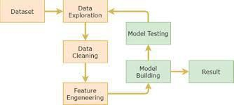
Features include transaction amount, balances, transaction type, and time
Target variable:
  isFraud = 1 → Fraudulent transaction
  isFraud = 0 → Legitimate transaction
The dataset closely simulates real-world banking transactions.
SLIDE 4: OVERALL PROJECT WORKFLOW (Diagram)
CONFIDENTIAL: The information in this document belongs to Boston Institute of Analytics LLC. Any unauthorized sharing of this material is prohibited and subject to legal action under breach of IP and confidentiality clauses.

Slide 5
Overall Project Workflow
Data collection and understanding
Data preprocessing
Exploratory data analysis
Feature engineering
Model training and evaluation
Model deployment
Fraud prediction and alert generation
Data Preprocessing Approach
Before building the model, the data was preprocessed to make it suitable for machine learning. Steps performed:
  Checked for missing and inconsistent values
  Encoded categorical features such as transaction type
  Scaled numerical features
  Removed unnecessary identifier columns
Why this step is important:
Machine learning models work best with clean, numerical, and well-structured data.
CONFIDENTIAL: The information in this document belongs to Boston Institute of Analytics LLC. Any unauthorized sharing of this material is prohibited and subject to legal action under breach of IP and confidentiality clauses.

Slide 6
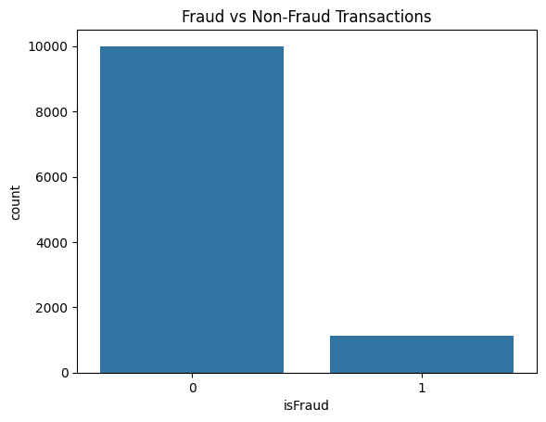
Exploratory Data Analysis (EDA)
EDA was performed to understand transaction behavior and fraud patterns.
Key insights:
  Fraud transactions are very rare compared to genuine ones
  The dataset is highly imbalanced
  Most fraud occurs in:
    TRANSFER
    CASH-OUT transactions
  Fraud transactions usually involve:
  1.High transaction amounts
  2.Sudden balance reduction
ADD YOUR GRAPHS HERE:
  Fraud vs Non-Fraud distribution graph
CONFIDENTIAL: The information in this document belongs to Boston Institute of Analytics LLC. Any unauthorized sharing of this material is prohibited and subject to legal action under breach of IP and confidentiality clauses.

Slide 7
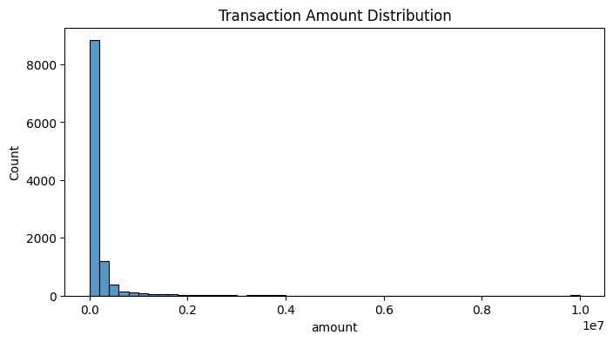
Transaction Type vs Fraud graph
These graphs visually justify why fraud detection is a challenging problem.
Feature Engineering
Feature engineering was done to improve model performance. Important engineered features:
  Balance difference between old and new balance
  Identification of high-risk transaction types
Why feature engineering is needed:
It helps the model capture hidden fraud patterns that are not directly visible in raw data.
Machine Learning Models Used
Two models were implemented:
  Logistic Regression
    Used as a baseline model
    Simple and interpretable
  Random Forest Classifier
    Handles complex, non-linear patterns
    Performs well on imbalanced data
    Commonly used in fraud detection systems
Random Forest performed better and was selected for further tuning.
CONFIDENTIAL: The information in this document belongs to Boston Institute of Analytics LLC. Any unauthorized sharing of this material is prohibited and subject to legal action under breach of IP and confidentiality clauses.

Slide 8
Model Evaluation & Final Selection Evaluation Metrics Used:
Precision – how accurate fraud predictions are
Recall – how many actual frauds are detected
F1-Score – balance between precision and recall
ROC-AUC – overall model performance
Recall was prioritized because missing fraud is more costly than false alerts. Final Model:
Random Forest with SMOTE
High recall
Stable and business-friendly performance
CONFIDENTIAL: The information in this document belongs to Boston Institute of Analytics LLC. Any unauthorized sharing of this material is prohibited and subject to legal action under breach of IP and confidentiality clauses.

Slide 9
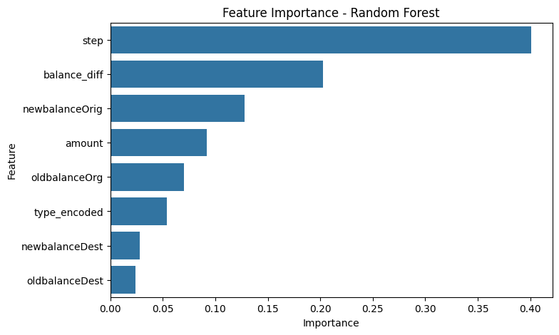
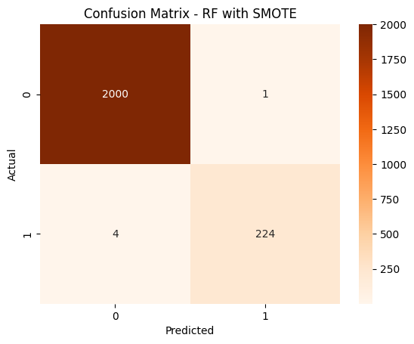
ADD YOUR GRAPHS HERE:
Feature Importance graph
Confusion Matrix
CONFIDENTIAL: The information in this document belongs to Boston Institute of Analytics LLC. Any unauthorized sharing of this material is prohibited and subject to legal action under breach of IP and confidentiality clauses.

Slide 10
10. End-to-End System Architecture
The complete system works as follows:
Transaction data is received
Data is preprocessed and scaled
The trained ML model predicts fraud probability
A threshold is applied
Transaction is classified as Fraud or Legitimate
Alerts are generated if fraud is detected This ensures smooth end-to-end fraud detection.
CONFIDENTIAL: The information in this document belongs to Boston Institute of Analytics LLC. Any unauthorized sharing of this material is prohibited and subject to legal action under breach of IP and confidentiality clauses.

Slide 11
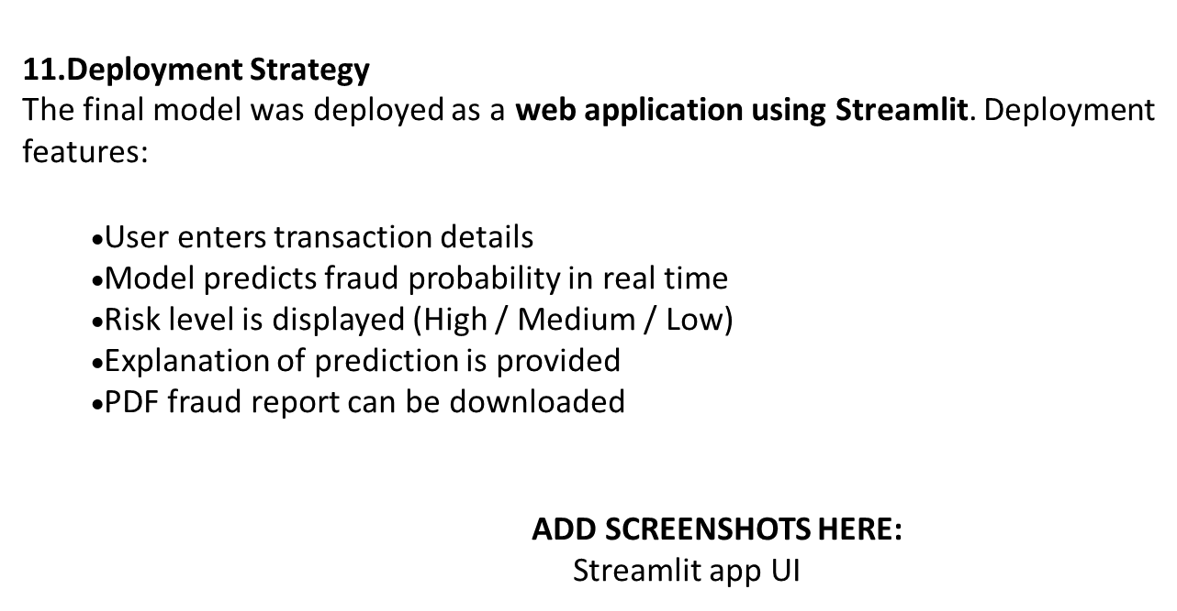
CONFIDENTIAL: The information in this document belongs to Boston Institute of Analytics LLC. Any unauthorized sharing of this material is prohibited and subject to legal action under breach of IP and confidentiality clauses.

Slide 12
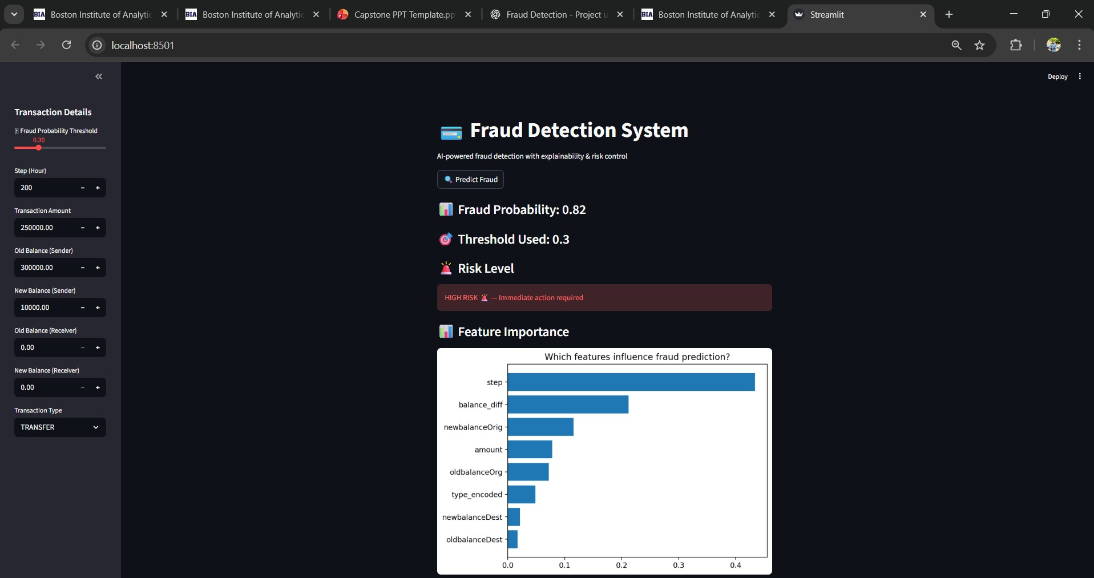
CONFIDENTIAL: The information in this document belongs to Boston Institute of Analytics LLC. Any unauthorized sharing of this material is prohibited and subject to legal action under breach of IP and confidentiality clauses.

Slide 13
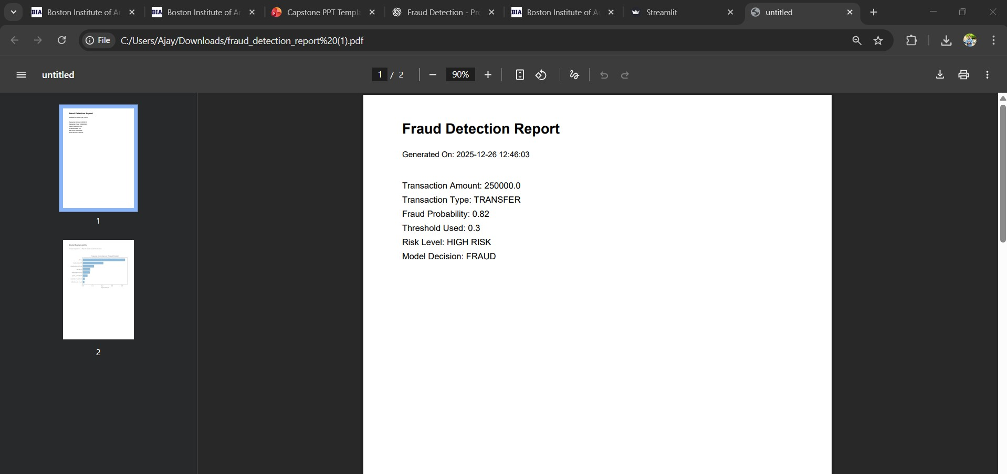
PDF report output
CONFIDENTIAL: The information in this document belongs to Boston Institute of Analytics LLC. Any unauthorized sharing of this material is prohibited and subject to legal action under breach of IP and confidentiality clauses.

Slide 14
This proves the project is fully implemented and deployable.
Results & Business Impact Results:
  Improved fraud detection performance
  High recall ensured fewer fraud cases were missed
  Better model reliability
Business Impact:
  Reduced financial loss
  Faster fraud response
  Improved customer trust
  Supports audit and compliance teams
13.Challenges Faced & Solutions Challenges:
  Highly imbalanced dataset
  Risk of missing fraud cases
  Need for explainable predictions
Solutions:
  Used SMOTE to handle imbalance
  Focused on recall instead of accuracy
  Added feature importance and AI explanations
CONFIDENTIAL: The information in this document belongs to Boston Institute of Analytics LLC. Any unauthorized sharing of this material is prohibited and subject to legal action under breach of IP and confidentiality clauses.

Slide 15
14.Future Enhancements
Possible future improvements include:
  Deep learning–based fraud detection
  Real-time transaction streaming
  Cloud deployment (AWS / Azure)
Advanced explainability using SHAP
Integration with banking APIs
Conclusion
This project demonstrates a complete end-to-end fraud detection system. Key highlights:
  Real-world business problem solved
  Full data science lifecycle covered
  Deployed and explainable ML solution
  Industry-ready and interview-ready project
CONFIDENTIAL: The information in this document belongs to Boston Institute of Analytics LLC. Any unauthorized sharing of this material is prohibited and subject to legal action under breach of IP and confidentiality clauses.

Slide 16


to answer any
ny unauthorized sharing of this
Thank You.
I would be happy questions ?
CONFIDENTIAL: The information in this document belongs to Boston Institute of Analytics LLC. A material is prohibited and subject to legal action under breach of IP and confidentiality clauses.

Slide 17
Thank You!

